Slide 1

Car Prices Dashboard – Interactive Analysis using Power BI
Unlocking Actionable Insights from 558,837 Car Sales Records

Slide 2
Driving Deeper: Our Dashboard Objectives
Our primary goal is to empower stakeholders with an interactive dashboard, transforming raw car sales data into actionable insights for strategic decision-making.
1
2
3
Performance Tracking
Market Hotspots
Value Drivers
Monitor key metrics: total sales, average price, and units sold across the market.
Identify top-performing brands, regions, and popular body types to refine market focus.
Explore the critical relationship between vehicle condition, odometer readings, and their impact on selling price.

Slide 3

Dataset at a Glance: Fueling Our Analysis
Our analysis is built upon a robust dataset sourced from car_prices.csv on Kaggle, comprising over half a million individual car sales records. This extensive data provides a comprehensive view of the automotive market.
Size: 558,837 rows × 16 columns
Key Columns Include:
year, make, model
body, transmission, condition
odometer, sellingprice
state, saledate

Slide 4
Key Performance Indicators: Our Dashboard Compass
These core KPIs provide a snapshot of market performance, offering immediate insights into sales volume, pricing trends, and inventory metrics.
SUM(sellingprice)
AVG(sellingprice)
COUNT(vin)
AVG(condition)
Total Sales Revenue
Average Selling Price
Cars Sold
Average Condition
Overall financial performance from all car sales.
The typical price point for vehicles sold.
Total volume of unique vehicles transacted.
Insight into the typical quality rating of sold cars.
AVG(odometer)
Average Odometer
Mean mileage of vehicles at the point of sale.

Slide 5
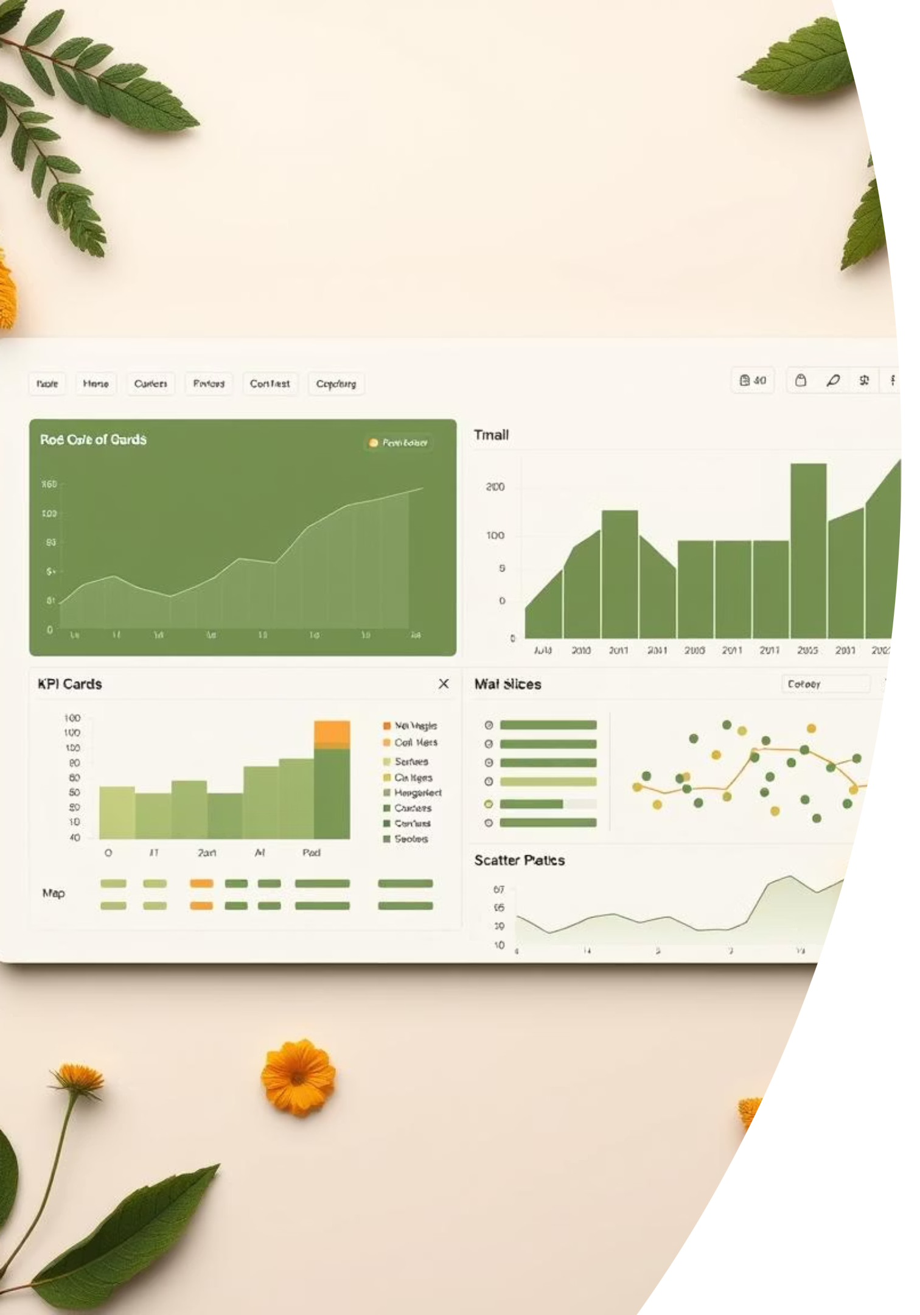
Dashboard Blueprint: A Visual Interface
Intuitive Design for Maximum Impact

Slide 6
Key Insights: What the Data Reveals
Our interactive dashboard swiftly highlights critical market dynamics, guiding strategic adjustments for sales and inventory.
SUV Dominance
Regional Powerhouses
SUVs command the highest average selling prices, indicating strong demand and value in this segment.
California and Texas emerge as leaders in total sales, signaling key markets for concentrated efforts.
Odometer's Influence
Brand Leaders
Vehicles with lower odometer readings consistently achieve higher selling prices, confirming mileage as a critical pricing factor.
Toyota and Ford maintain their positions as top-selling brands, reflecting consumer preference and market share.

Slide 7

Strategic Advantages: Empowering Decision-Makers
The Power BI dashboard enables swift, interactive exploration of car sales data, providing a dynamic tool for market analysis.
Stakeholders can easily filter data by year, brand, and state for highly targeted market insights.
The interactive nature supports agile decision-making and rapid response to market shifts.
Ultimately, this deep-dive analysis significantly supports optimized inventory planning and the development of dynamic, competitive pricing strategies.

Slide 8



Beyond the Dashboard: Future Enhancements
To further elevate our analytical capabilities, we plan to implement several advanced features, providing even richer insights and proactive tools for sales and strategy.
Real-time Data Refresh
Customer Demographics
Automate data pipelines to ensure the dashboard reflects the most current market information, supporting real-time decision-making.
Predictive Price Estimation
Incorporate additional data points on customer profiles to enable more precise segmentation and targeted marketing campaigns.
Integrate machine learning models to forecast optimal selling prices based on market conditions and vehicle attributes.

